Slide 1
Overview of Tubman & Roseway Heights Feeder Pattern Proposal
PPS Board of directors
September 12, 2017

Slide 2
Expected Outcomes
Immediately open access to Middle Schools for 1200 6-8 grade students; and, an additional 3400 K-5 students in the 8 feeder schools
Provide access to a comprehensive Middle Years program that is integrated, challenging, and exploratory
Provide clear articulation to middle schools for 3 Dual Language Immersion Programs (Mandarin DLI at MLK, Jr; Spanish DLI at Scott; and Vietnamese at Rose City Park)
Provide a single high school feeder pattern for families in the new catchment areas
Relieve the facilities over-crowding that currently impacts Lee, Scott, and Beverly Cleary
Yields resulting K-5s with “balanced enrollment” in 7 of the 8 feeders
Notes:
2 DLI programs together are not small: 140 K-4 at King; 80 K-2

Slide 3
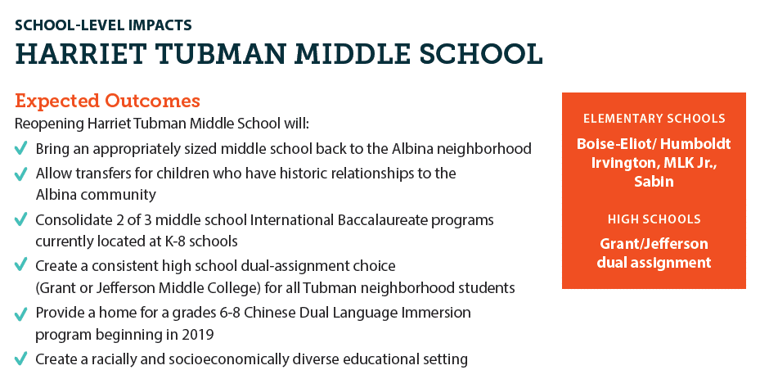
Overview- Harriet Tubman Middle School
Notes:
Chinese DLI from MLK Jr (@24 students in grade 6)

Slide 4
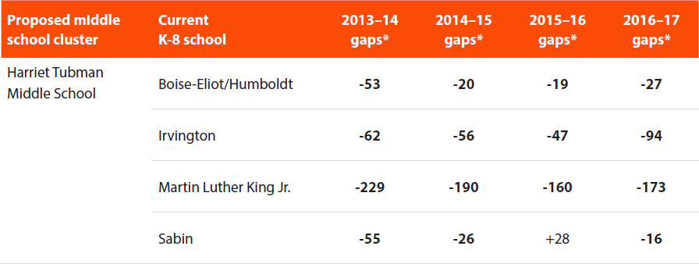
Why are boundary changes proposed?
To address under-enrollment of feeder schools that leave resulting K5 schools at-risk of not having equitable staffing and programming
To balance and bolster enrollment at co-located DLI schools
Notes:
The proposal introduces boundary changes that would specifically help to balance the enrollment at MLK, Jr AND Irvington, noting their low enrollment above
1) Currently, Determining if a K5 school meets the right size in PPS is defined by the number “360”,

Slide 5
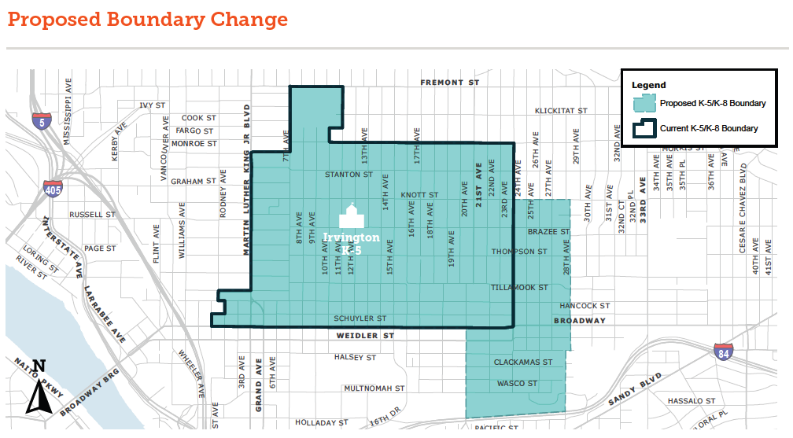
Irvington / Beverly Cleary

Slide 6
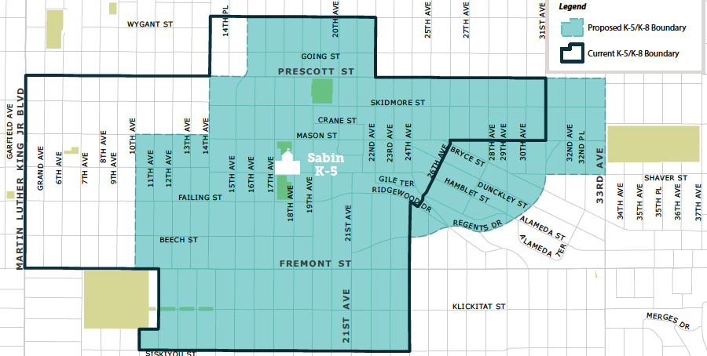
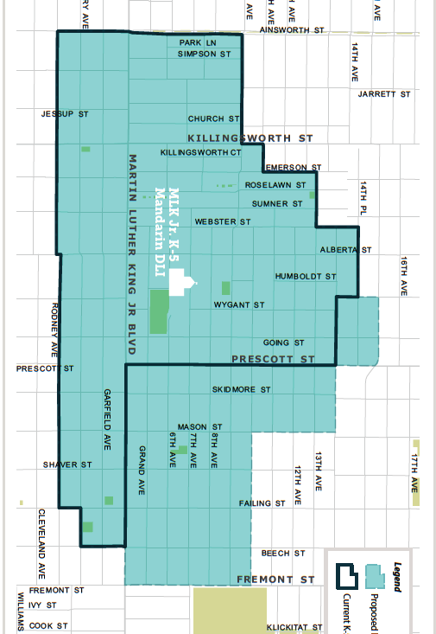
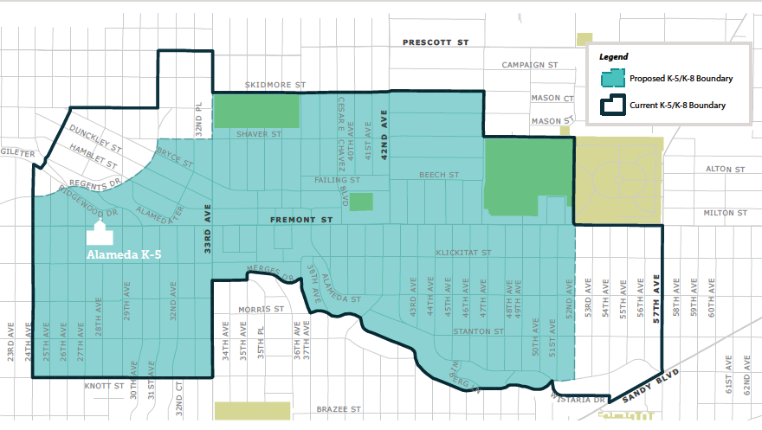
MLK, Jr. / Sabin / Alameda
Notes:
Sabin to MLK Jr: 19
Alameda to Sabin: 10
Increases King enrollment to 449 (178 are DLI students)…correct delta is 369 to 439
Part of the challenge is to determine where there are high-densities of students living

Slide 7
Boundary Change Implementation Plan
Gradual Implementation of new Boundaries
  Change in MLK, Jr and Sabin boundary is currently proposed to begin with incoming Kindergarten students only in 2018-19
  Change in Sabin and Alameda boundary is currently proposed to begin with incoming Kindergarten students only in 2018-19
Immediate Implementation of new Boundaries
  Change in Irvington & Beverly Cleary would be implemented immediately for incoming K-5 students due to the significant space constraints on Beverly Clearly campuses

Slide 8
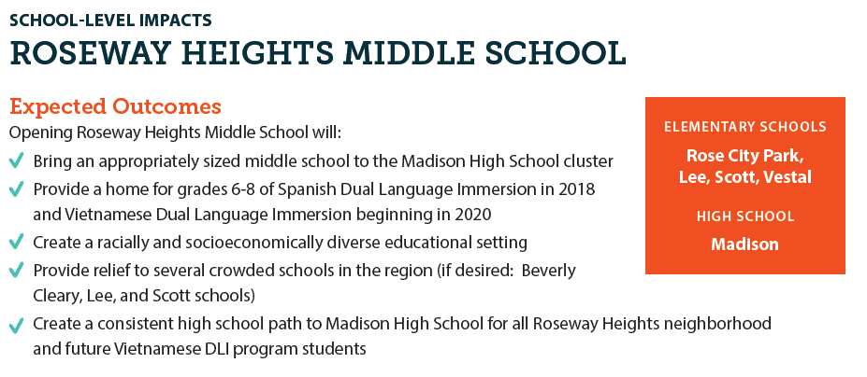
Overview- Roseway Heights Middle School

Slide 9
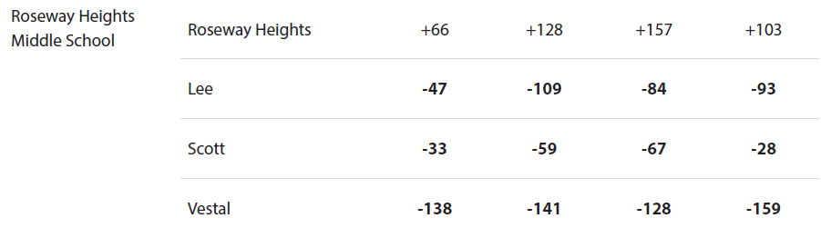
Why are boundary changes proposed?
To address under-enrollment of feeder schools that leave resulting K5 schools at-risk of not having equitable staffing and programming
To balance and bolster enrollment at co-located DLI schools
Notes:
Lee & Scott are under-enrolled as K-8s and yet they face over-crowding as K-8s given the capacity of the facilities they are in. So, the plan for Lee & Scott needs to create large enough K5’s that would still fit in the building. Scott has the co-located DLI program

Slide 10
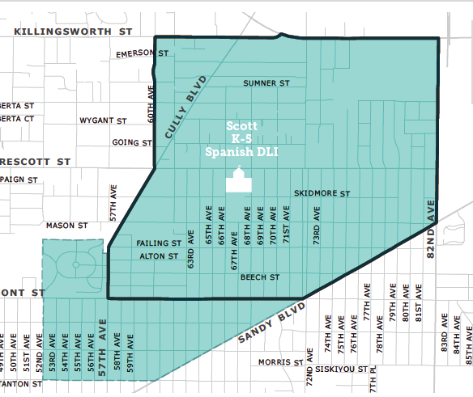
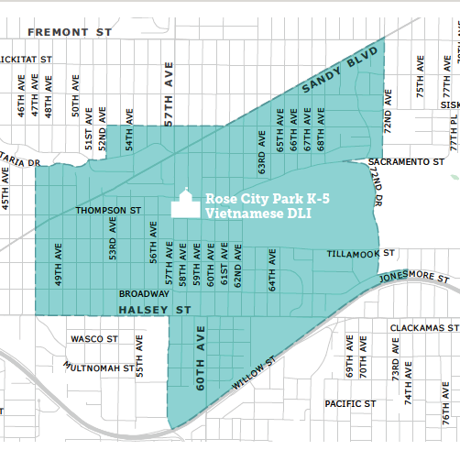
Scott / Alameda / Rose City Park
Notes:
Alameda to Scott: 8
Alameda to Rose City Park: 3
Rose City Park to Scott: 7

Slide 11
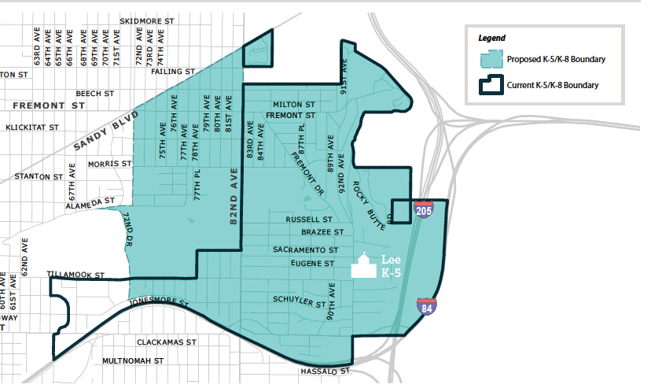
Rose City Park / Lee
Notes:
Rose City Park to Lee: 15
Lee to Rose City Park: 4

Slide 12
Boundary Change Implementation Plan
Gradual Implementation of new Boundaries
  Change in Lee boundary is currently proposed to begin with incoming Kindergarten students only in 2018-19
  Small change in Scott & RCP boundary (from Alameda) would begin with incoming Kindergarten students only in 2018-19
Immediate Implementation of new Boundaries
  Change in Rose City Park & Beverly Cleary would be implemented immediately for incoming K-5 grade students due to the significant space constraints on Beverly Clearly campuses

Slide 13
Community Engagement
Informal sessions with parent groups in impacted schools; and additional school-based sessions in process
Community Engagement Sessions for Roseway Heights & Tubman to introduce the planning process for programming and student supports
Conversations with key community leaders and internal stakeholders are ongoing
Details at https://www.pps.net/middleschools

